Slide 1
Computer Vision Detecting Hand Gestures
By Christopher villafuerte

Slide 2
Opportunity Statement
To create a more human interface to interact with a computer system.
Stage 1 – to have a computer system interact with pre-defined gestures
Stage 2 – to have a model intuit human needs through our gestures ( as the family dog uses observation to reactively communicate)

Slide 3
Goal Of This Project
To train a convolutional neural network to identify particular hand gestures

Slide 4
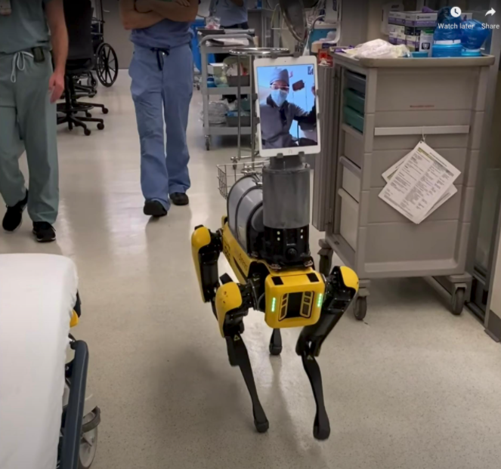
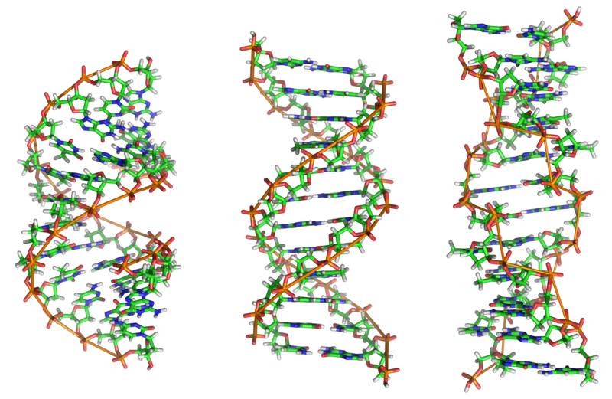
Computers & our Society
Scientific Research
Medical

Slide 5
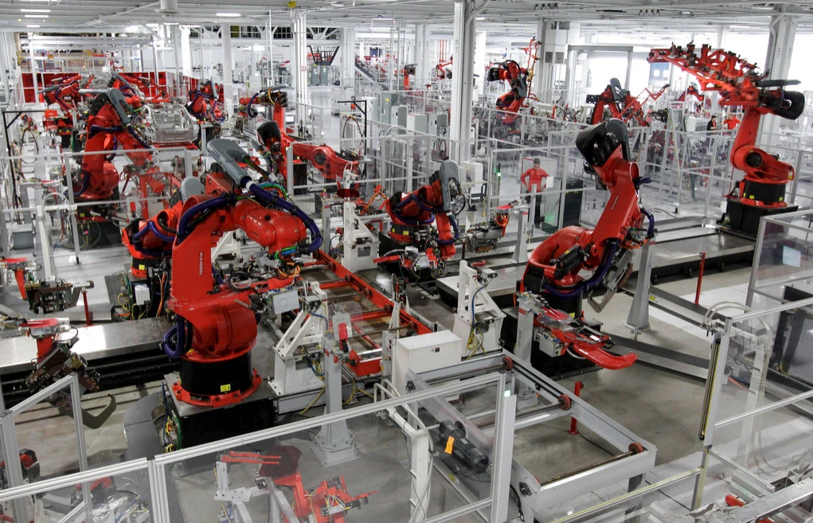
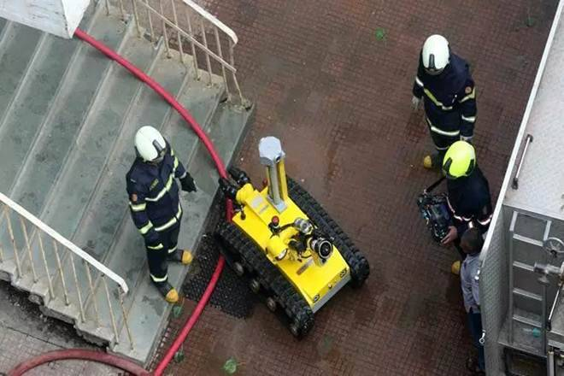
Computers & our Society
Manufacturing
First Responders

Slide 6


Computers & our Society
Homes

Slide 7
Process
Data
Modeling
Results
What is next

Slide 8
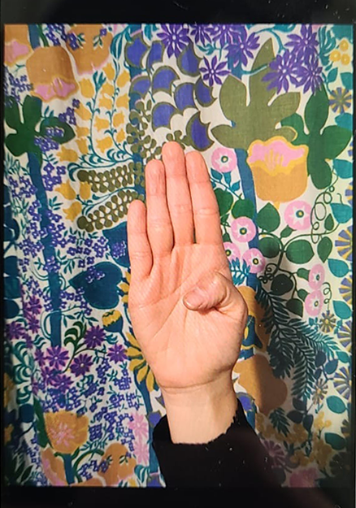
Data
Camera phone, webcam, opensource archive, and DSLR 35mm camera

Slide 9
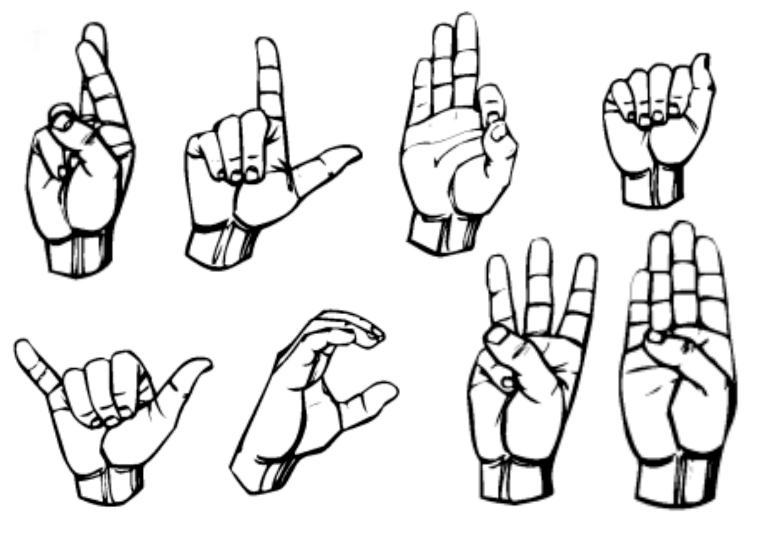
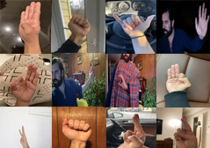
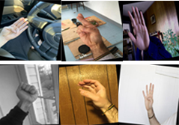
Data data teaches your network – be a good teacher
9 Classes
400 units of data
1,200 augmented
Diversity of subjects, positions, lighting situations, on different backgrounds
Brightness, warping, rotation, color saturation,

Slide 10
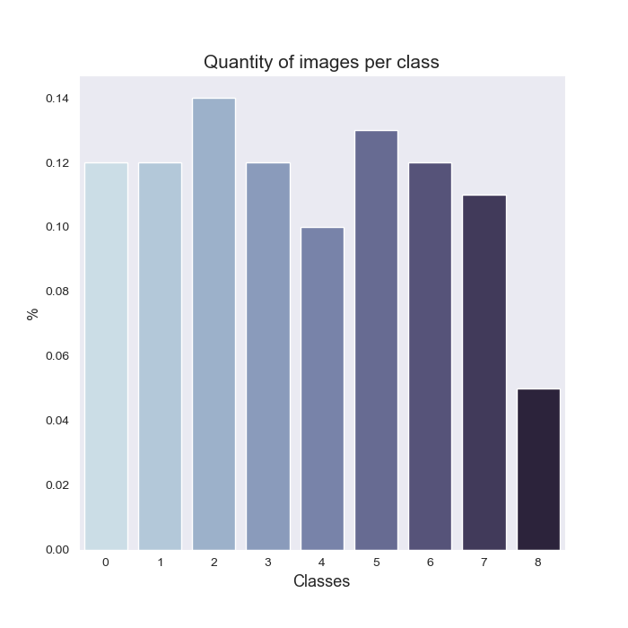
Balance of Classes

Slide 11
Model YoloV4 tiny on Darknet
Fast SSD model
High accuracy score
Pre-trained weights (transfer learning)
Built for democratization of computer vision
Notes:
Darknet is an open source neural network framework written in C and CUDA.

Slide 12
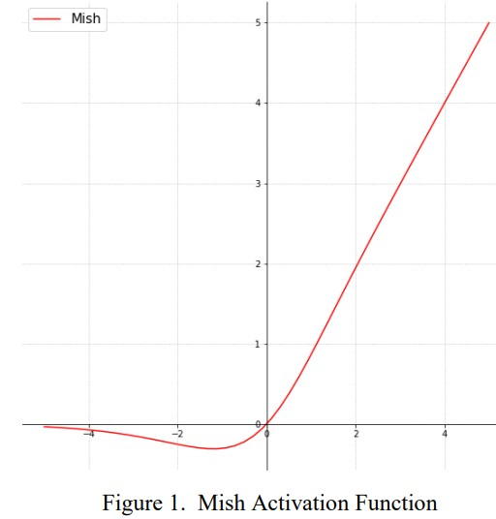
Hyperparameters
Activation Layers
Learning Rates
subdivisions
Leaky & Mish
.01, 001, 0001
1, 4, 16

Slide 13
Lets see it…

Slide 14
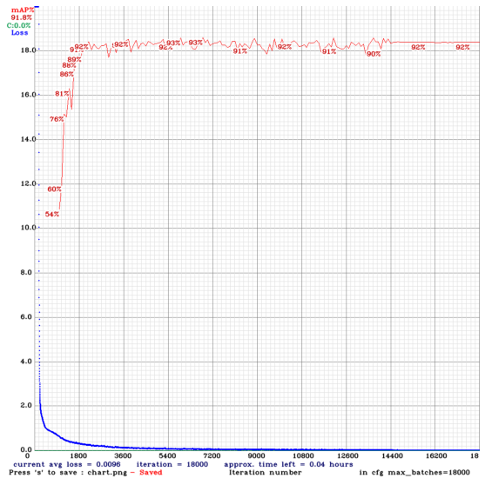
Model Performance
mAP = 92.96 %

Slide 15
Accuracy Scores
Class | Average Precision | TP | FP
Forward | 90.00 | 9 | 2
Back | 100 | 10 | 0
Left | 83.33 | 5 | 0
Right | 91.82 | 10 | 2
Input | 90 | 5 | 1
Plus | 81.48 | 8 | 1
Three | 100 | 5 | 2
Seven | 100 | 7 | 1
Five | 100 | 2 | 0
recall = 0.91
precision = 0.87
F1-score = 0.89

Slide 16
Results
Good performance
speed - 1 sec detection time
Need more and more data
Notes:
Darknet is an open source neural network framework written in C and CUDA.

Slide 17
What is Next
Test different element's of the data in small batches and compare mAP. Isolating: angle of view & rotation
Creating better tools to manage data workflow
Look into other models such as Mediapipe (trained on 30K hands)
Look into passively collecting data, ‘clustering’ for body movements.
Notes:
Darknet is an open source neural network framework written in C and CUDA.

Slide 18
What is Next, Next
To examine the implications and uses of computers intuiting full body gestures.
Gesture types
Public / shared dictionary of gestures, ex: hand wave, a smile, head node.
Private / personal gestures. This vocabulary of gestures would give deep insight into who you are and how you act.
Notes:
Darknet is an open source neural network framework written in C and CUDA.

Slide 19
Thank you

Slide 20
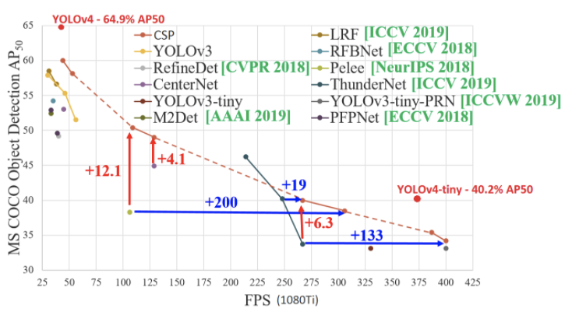
How fast, fast…

